Slide 1
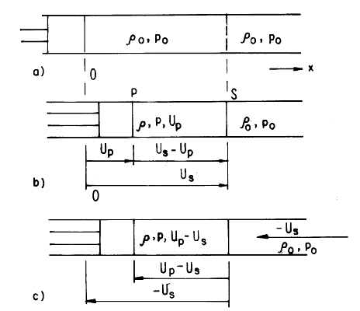
1D Shock Wave Propagation in Solids
Josh Bevan, Spring 2012, 22.520

Slide 2
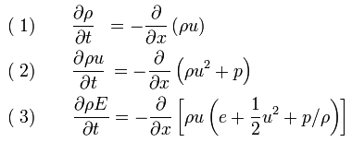
Physical Analog
Very similar in concept to fluid shock
Satisfies Euler Equations, in 1D form:
Satisfies same conservative laws: momentum, mass, and energy

Slide 3

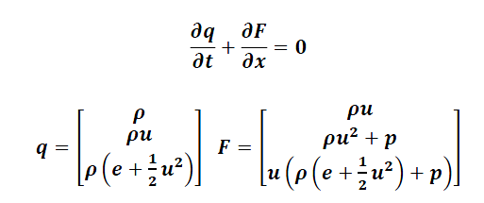
Rankine–Hugoniot jump conditions
In order to bridge shock discontinuity jump condition employed
In this case three conservative laws to be satisfied, taking similar matrix form:

Slide 4
Material Dependent Behavior
Constitutive relation required to describe material behavior
Many models possible for solids, no compelling analytical model. Most based on empirical relations for particular class of behavior.
Mie–Gruneisen equation of state commonly employed for compression of solids

Slide 5

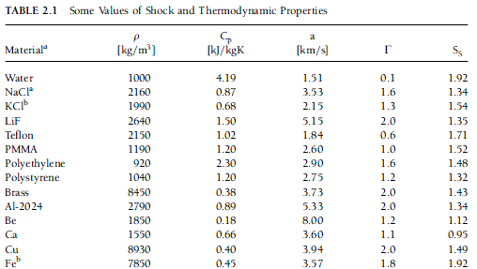
Mie–Gruneisen equation of state
Based on more general Gruneisen model, relating volumetric change to crystal lattice behavior:
Γ , Grüneisen parameter represents thermal pressure from set of vibrating atoms

Slide 6


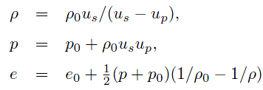
Mie–Gruneisen equation of state
If Γ treated as independent of p and e, integrating the model yields:
If shock and particle speed treated as linearly dependent:
Then jump conditions become:

Slide 7
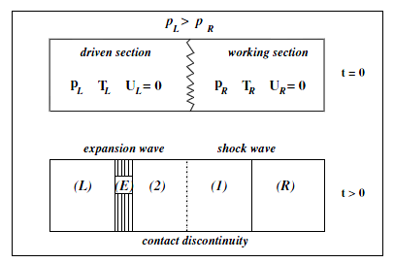
Basic Shock behavior

Slide 8

Implementation
Finite volume approach with Lax-Friedrich flux function
Explicit method requires Courant–Friedrichs–Lewy condition to be satisfied
Range of Courant numbers examined
Important to balance convergence with dissipative effects

Slide 9
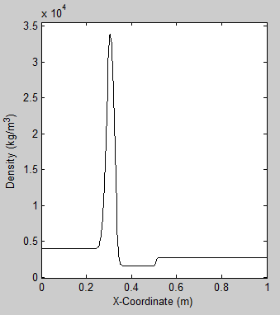
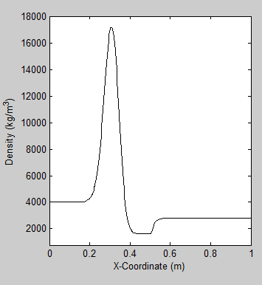
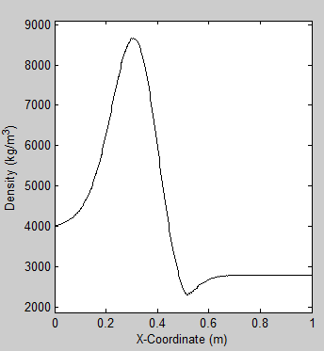
Courant number effects
0.95 0.35 0.1

Slide 10
Model parameters
Semi-infinite aluminum slabs
One compressed to 4 g/cm³ with P=8 GPa, other at p₀
Impact of one slab at 2000 m/s

Slide 11
Model Results, t=0

Slide 12
Model Results, t=50 us

Slide 13
Model Results, t=150 us

Slide 14
Model results, t=300 us

Slide 15
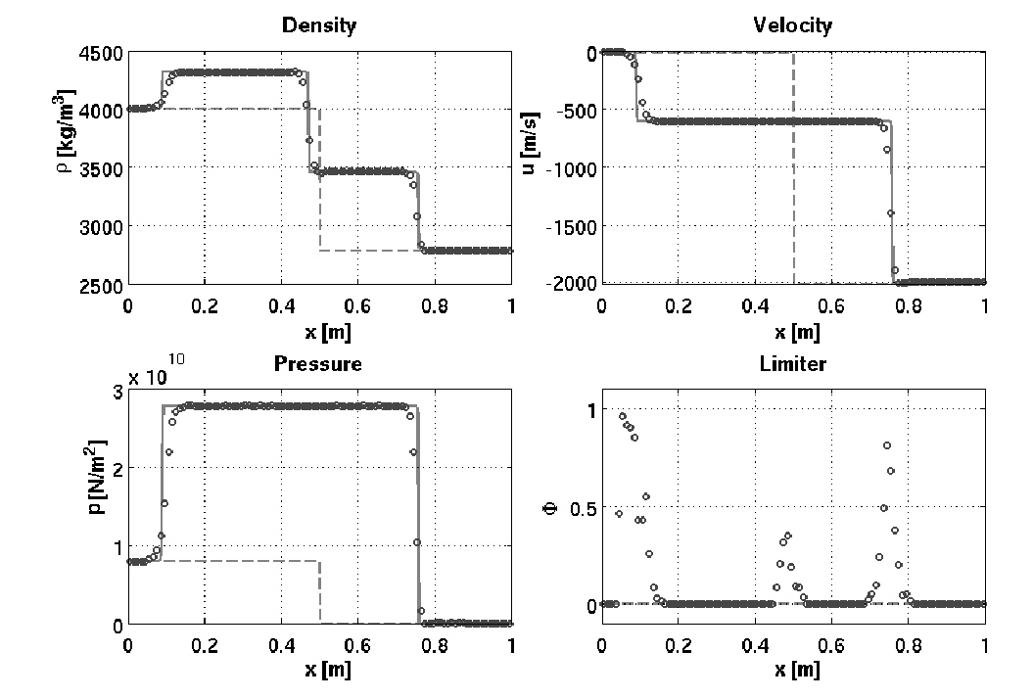
Literature comparison, Ward [2]

Slide 16
References
1 Linear and Nonlinear Waves http://www.math.umn.edu/~olver/pdn.html
2 The simulation of shock- and impact-driven flows with Mie-Gruneisen equations of state http://thesis.library.caltech.edu/6211/1/ward_thesis.pdf
3 Shock and detonation modeling with the Mie-Gruneisen equation of state http://www2.galcit.caltech.edu/EDL/publications/reprints/galcit_fm99-8.pdf
4 The Mechanical Threshold Stress model for various tempers of AISI 4340 steel http://www.csafe.utah.edu/pdf/papers/2005_Banerjee_(AISI_4340_Steel).pdf
5 An Exact Solution of the Riemann Problem for Solids with the Grüneisen Equation of State http://jpsj.ipap.jp/link?JPSJ/57/9
6 Grüneisen equation of state for solids and solution of the Riemann problem http://link.springer.com/chapter/10.1007%2F978-3-642-77648-9_70
7 A lattice Boltzmann method for shock wave propagation in solids http://www.ewp.rpi.edu/hartford/~ernesto/F2010/EP1/Materials4Students/Danyluk/Xiao2007.pdf
8 The Method of Characteristics with applications to Conservation Laws http://www.scottsarra.org/shock/shock.html
9 Handbook of Shock Waves, “General Laws for Propagation of Shock Waves through Matter (Ch 2)”, Leroy F. Henderson

